Slide 1
Topic: Scale Factor Eq: How do we find the scale factor?
Year 9

Slide 2
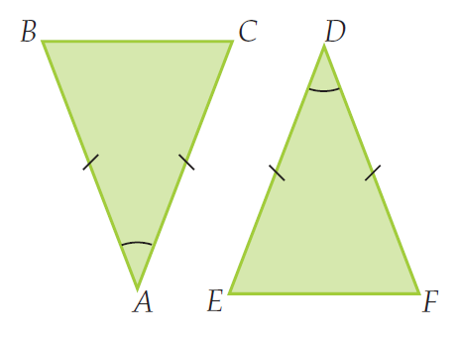
5 questions
Complete last lessons summary.
Draw a scalene triangle.
What is an isosceles triangle?
What does congruent mean?
Are the following two triangles congruent? Prove it.
Topic: Scale Factor Eq: How do we enlarge and reduce triangles?

Slide 3
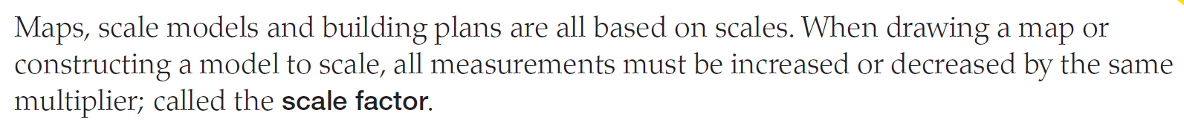
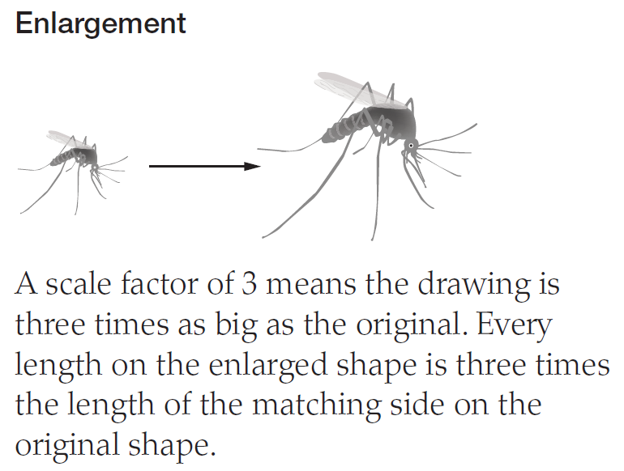
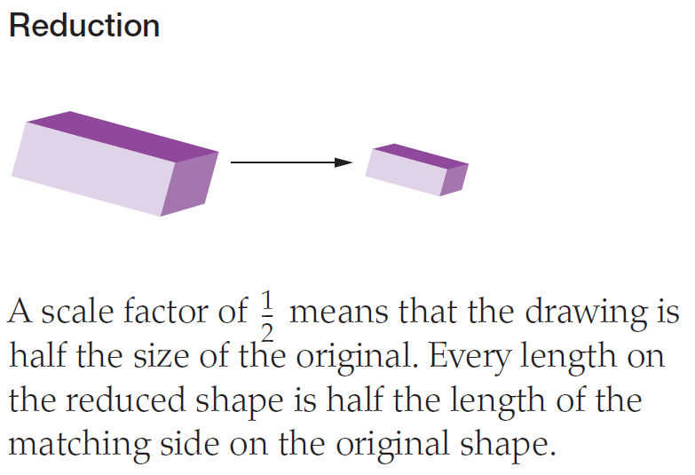
24
7
30
Scale Factor
Date
EQ – How do we find the scale factor?
What does scale factor mean?

Slide 4
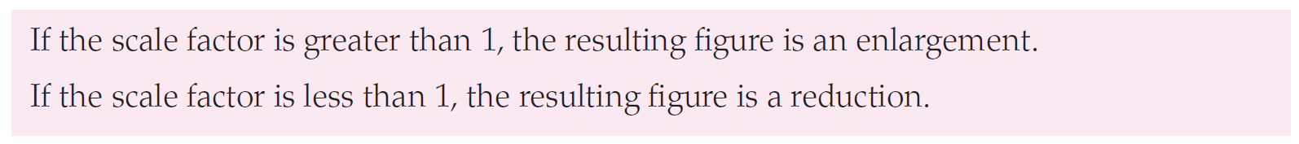
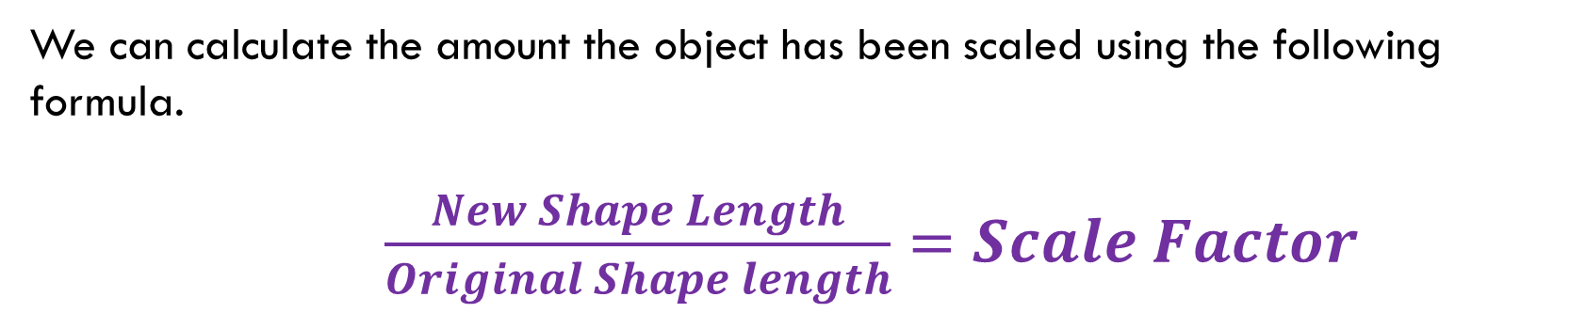
24
7
30
Scale Factor
Date
EQ – How do we find the scale factor?
How do we calculate the scale factor?
We can calculate the amount the object has been scaled using the following formula.
$\frac{New Shape Length}{Original Shape length}=Scale Factor$

Slide 5
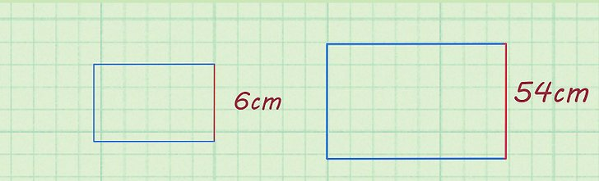

Example 1
Original Shape New shape
$\frac{New Shape Length}{Original Shape length}=Scale Factor$
In this case, the scale factor is greater than 1 so the shape has been enlarged.
Was the shape enlarged or reduced? Why?

Slide 6
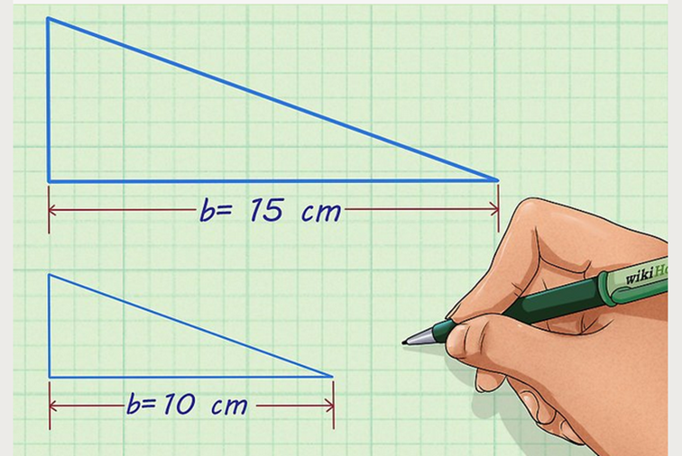

Example 2
Original Shape
New shape
$\frac{New Shape Length}{Original Shape length}=Scale Factor$
A scale factor less than 1 means the shape has been reduced.
Was the shape enlarged or reduced? Why?

Slide 7
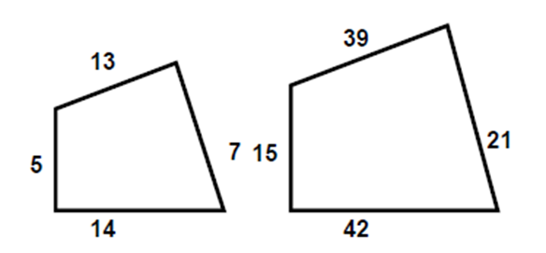









Example 3
Original Shape New shape
$\frac{New Shape Length}{Original Shape length}=Scale Factor$
Does the scale factor apply to each number pair?

Slide 8

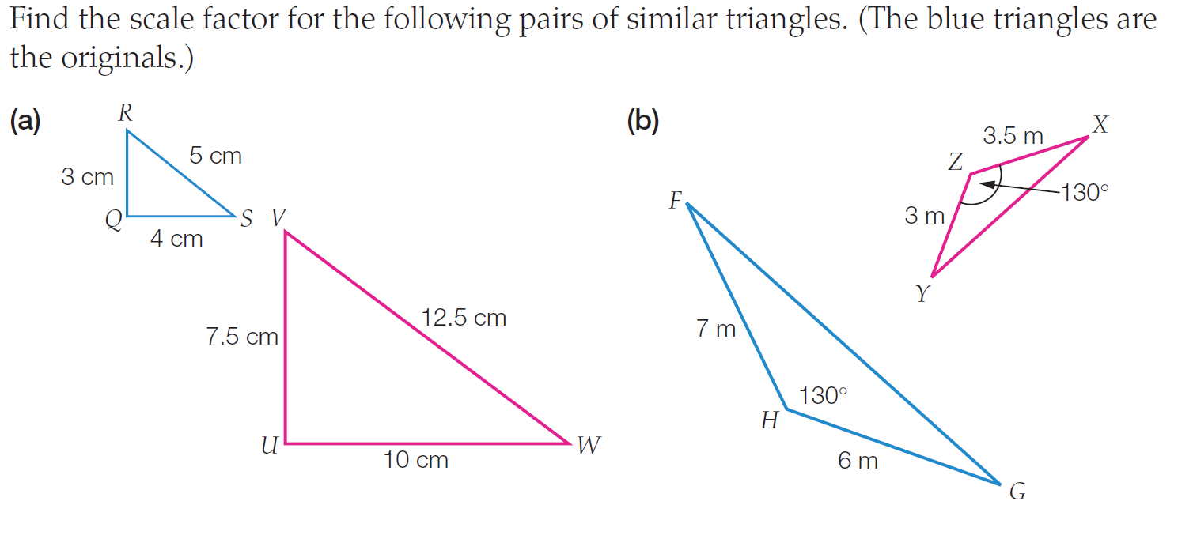
Task on the L.H.S

Slide 9
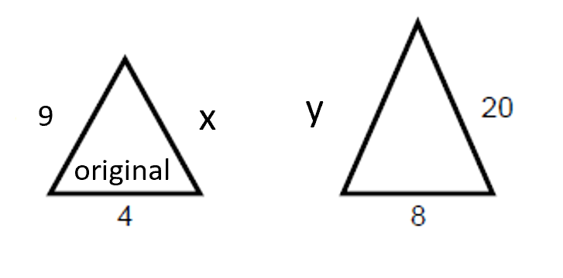


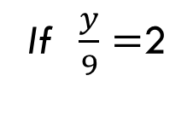

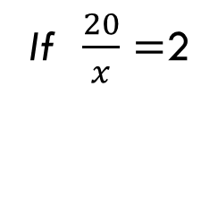
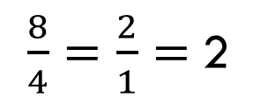
Example 4
Finally, if we know the scale factor, and we know the shapes are similar, we use that to find the lengths of unknown sides.
Find the scale factor
Use the scale factor to find the missing sides
$\frac{New Shape Length}{Original Shape length}=Scale Factor$
If $\frac{20}{x}=$2
$$then x must=10$$
$\frac{8}{4}=\frac{2}{1}=$2
If $\frac{y}{9}=$2
$$then y must=18$$

Slide 10
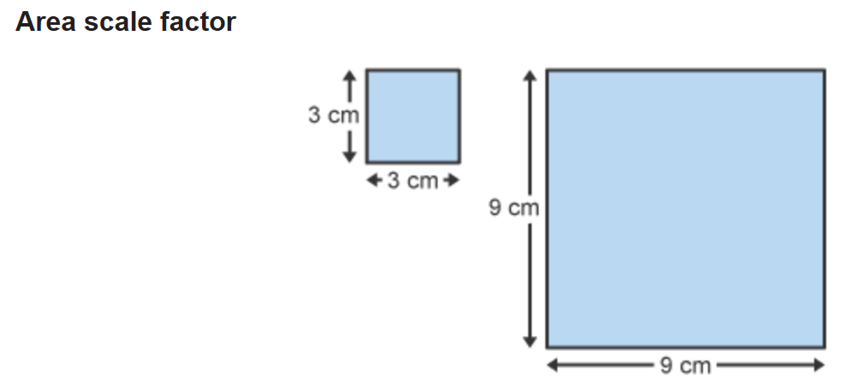


24
7
30
Scale Factor
Date
EQ – How do we find the scale factor?
Extension Work
How do we calculate the scale factor using the shapes area?
The lengths of the larger square are 3 times longer than the smaller square.
Hence the scale factor is 3
The area of the small square is 9${cm}^{2}$ and the area of the larger square is 81${cm}^{2}.$
How much larger is the area of the larger square?
If the scale factor is $m$ then the area scale factor is $m^{2}$

Slide 11
You have 3 minutes to write a summary that answers the Essential Question.
Be prepared to share your summary with the people sitting in your row.
Write your summary

Slide 12
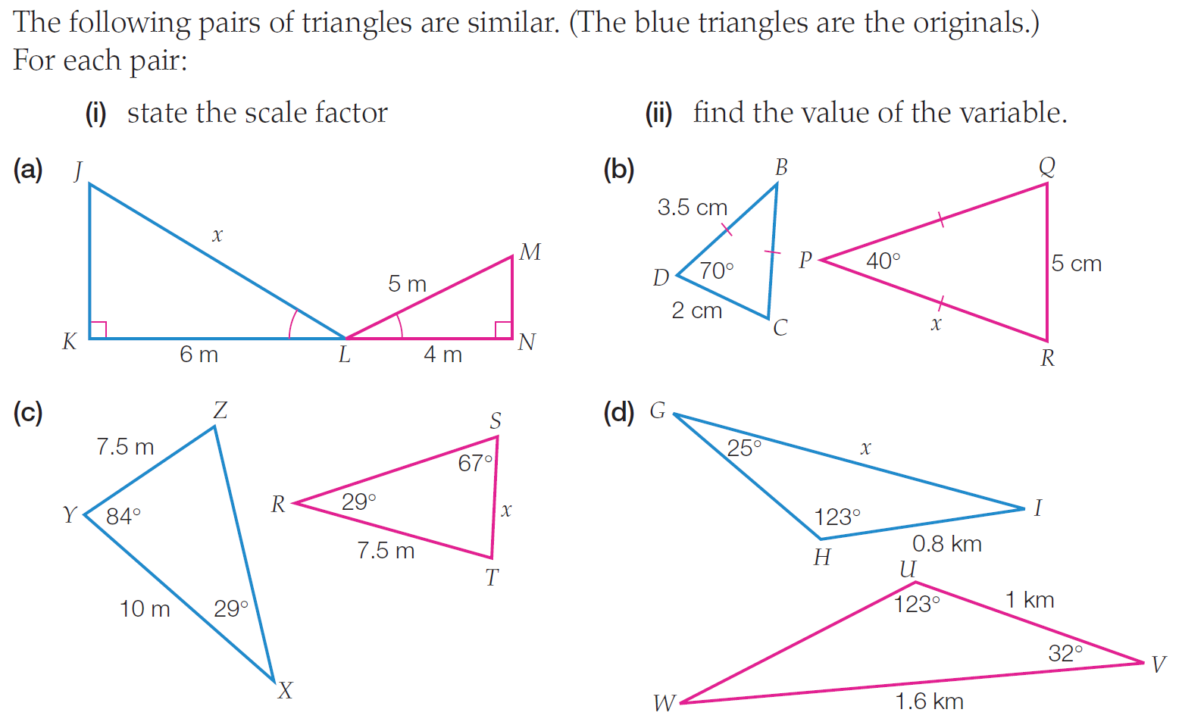
Task on the L.H.S

Slide 13
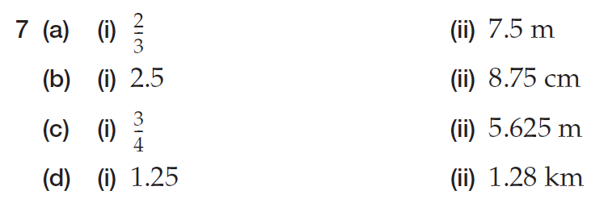
answer

